Slide 1
How to build an Industry Cost Profile (ICP) for a product in South Africa
Identify industry code based on the supplier’s business and product
Step 2
Identify data sources for financial and manufacturing information related to industry code
Step 3
Step 1
Use industry data to calculate ratios for DM, DL, MOH, COGS, GSA & PBT

Slide 2
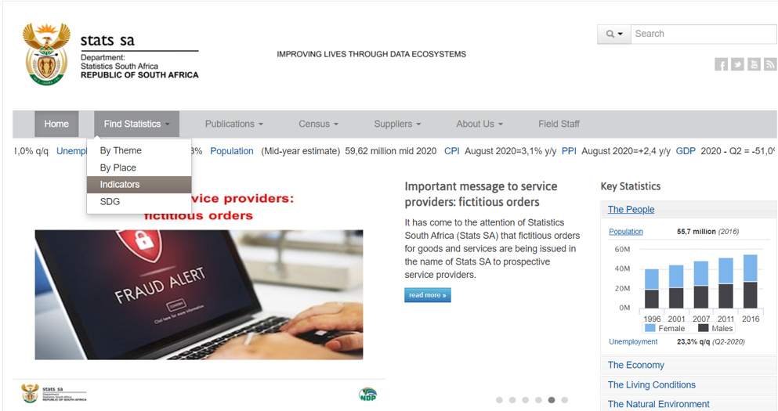
Identify Industry & obtain Financial and Manufacturing Information Related to Industry
Steps 1 & 2
Go to:
Click on “Find Statistics” and select “Indicators”
http://www.statssa.gov.za/

Slide 3
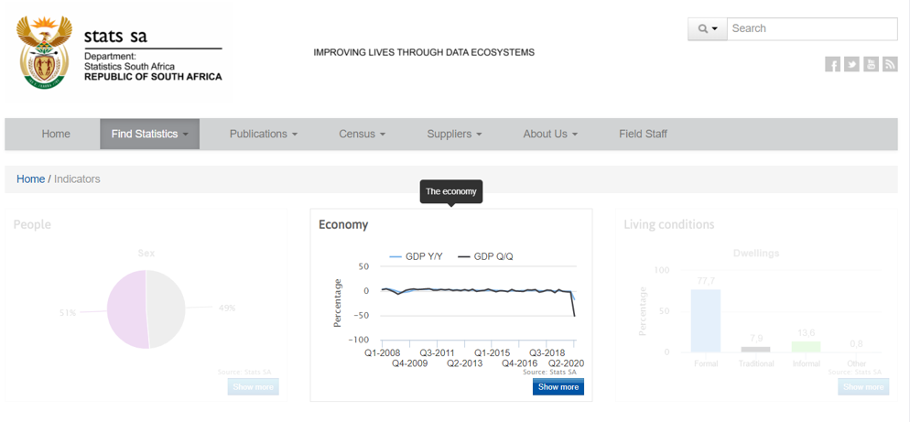
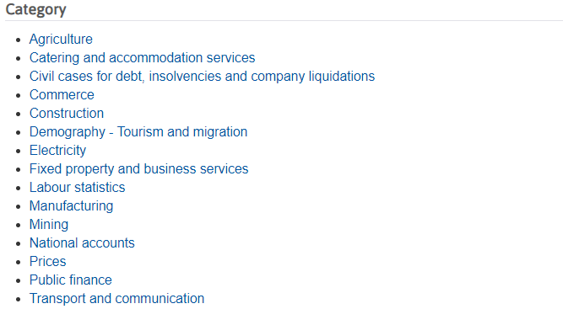
Identify Industry & obtain Financial and Manufacturing Information Related to Industry
Steps 1 & 2
Under the graph titled “Economy” select “Show more”
From the subsequent list of “Categories” select “Manufacturing”

Slide 4
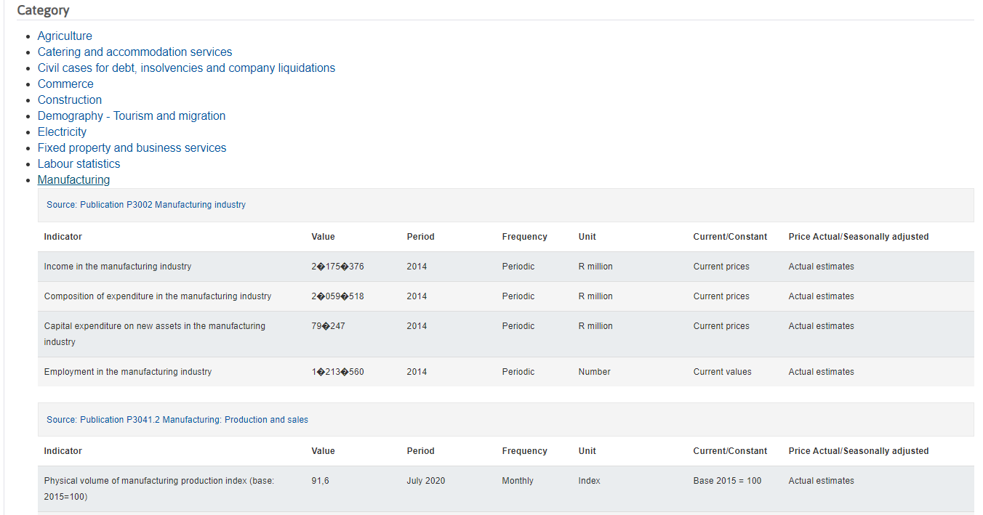
Identify Industry & obtain Financial and Manufacturing Information Related to Industry
Steps 1 & 2
From the subsequent list of “Categories” select “Manufacturing”
Scroll down until you find the table titled “Source: Publication Report-30-02-03 Manufacturing industry - financial detail” Click on the link

Slide 5
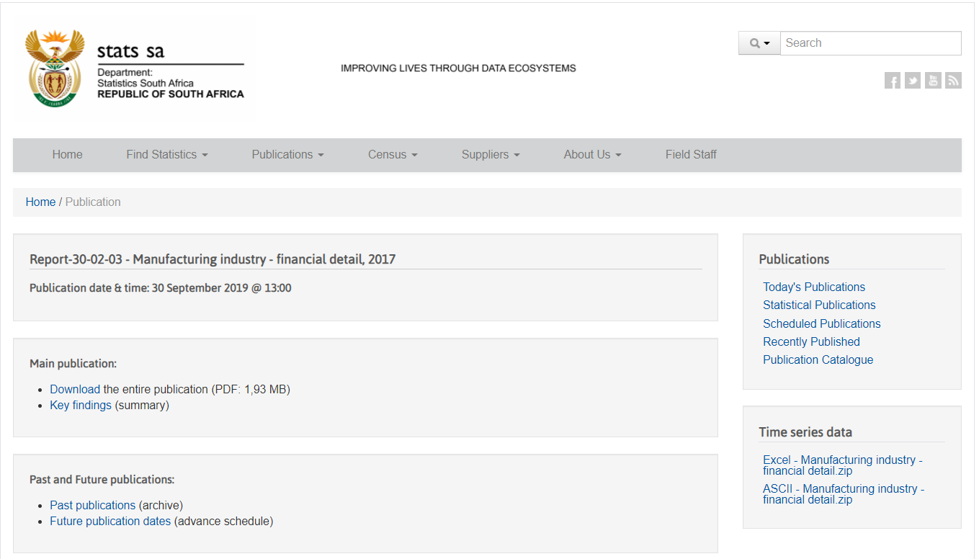
Identify Industry & obtain Financial and Manufacturing Information Related to Industry
Steps 1 & 2
Download the PDF containing the data

Slide 6
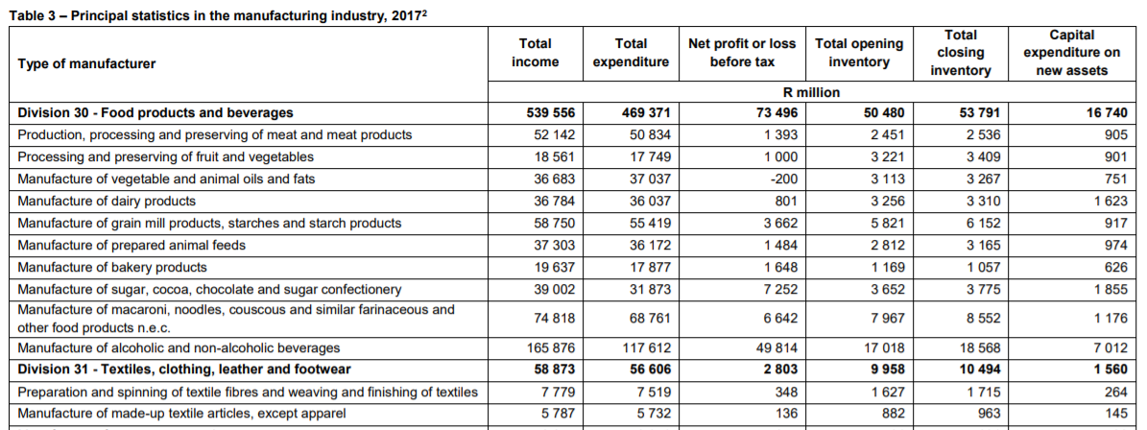
Identify Industry & obtain Financial and Manufacturing Information Related to Industry
Steps 1 & 2
Open the downloaded PDF
Go to Table 3 – Principal Statistics in the Manufacturing Industry
Scroll down to “Division 35- Metals, metal products, machinery and equipment” and record values for “Total Income” and “Net profit or loss before taxes” from this table for “Casting of iron, steel and non-ferrous metals”

Slide 7
Identify Industry & obtain Financial and Manufacturing Information Related to Industry
Steps 1 & 2
Go to Table 11 – Expenditure in the Manufacturing Industry
Scroll down to “Division 35- Metals, metal products, machinery and equipment” and record values for “Purchases” and “Salaries and wages paid” from this table for “Casting of iron, steel and non-ferrous metals”

Slide 8
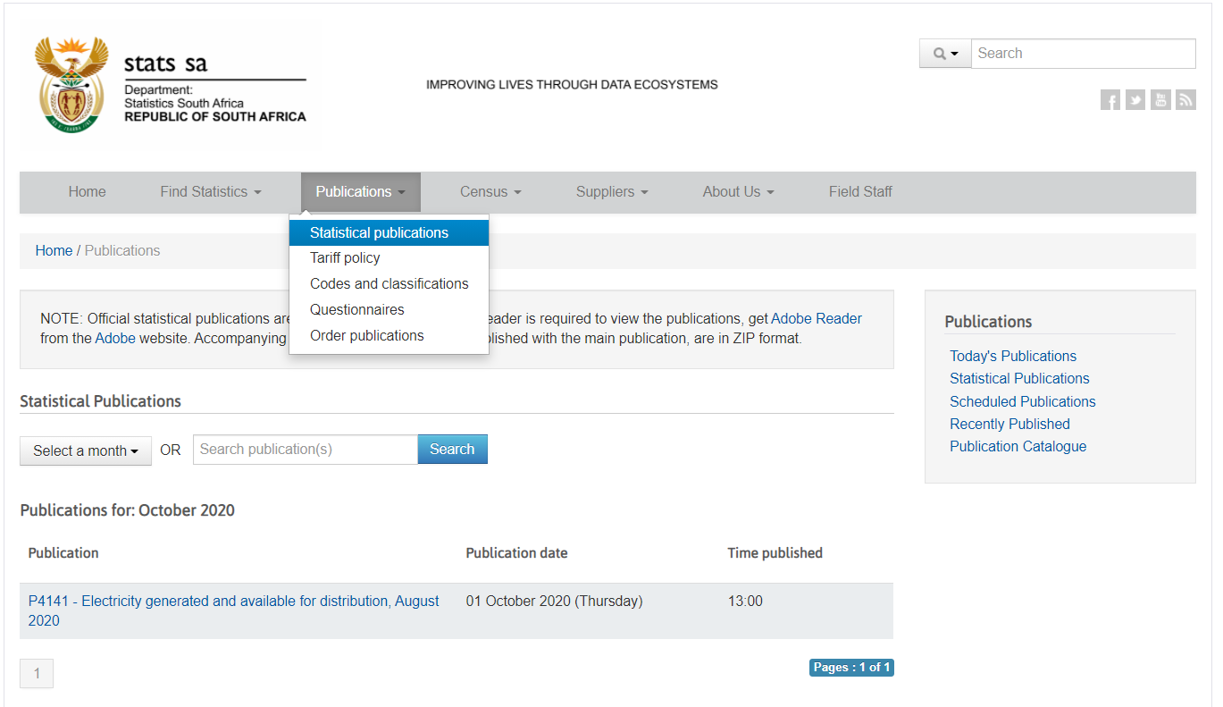
Identify Industry & obtain Financial and Manufacturing Information Related to Industry
Steps 1 & 2
Go to:
Click on “Publications” and select “Statistical Publications”
http://www.statssa.gov.za/

Slide 9
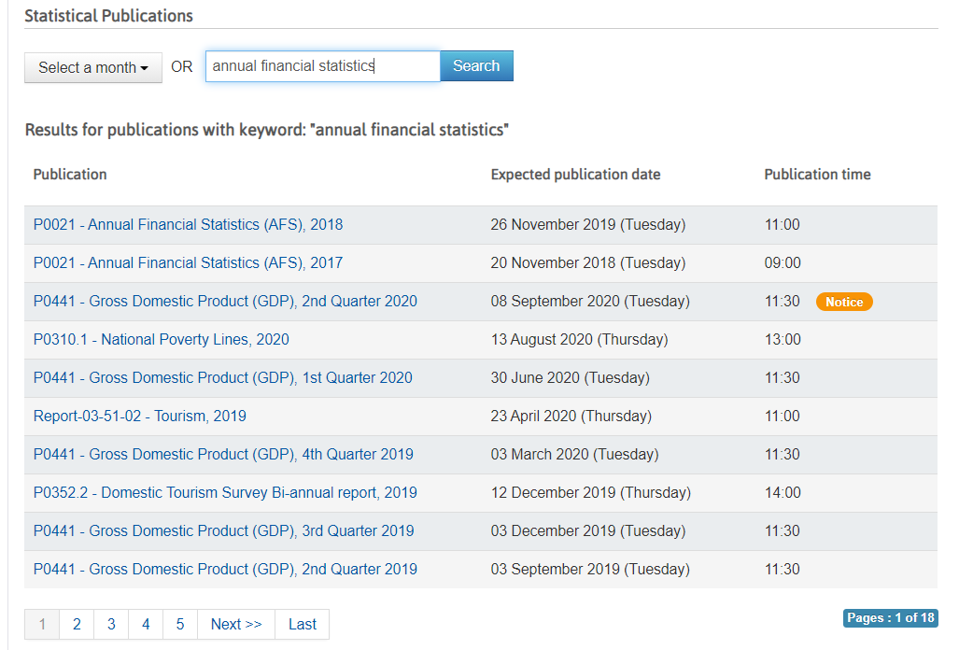
Identify Industry & obtain Financial and Manufacturing Information Related to Industry
Steps 1 & 2
Search for “Annual Financial Statistics” in the Search Bar
Click on the latest Annual Financial Statistics and download the PDF of the data on the next page

Slide 10
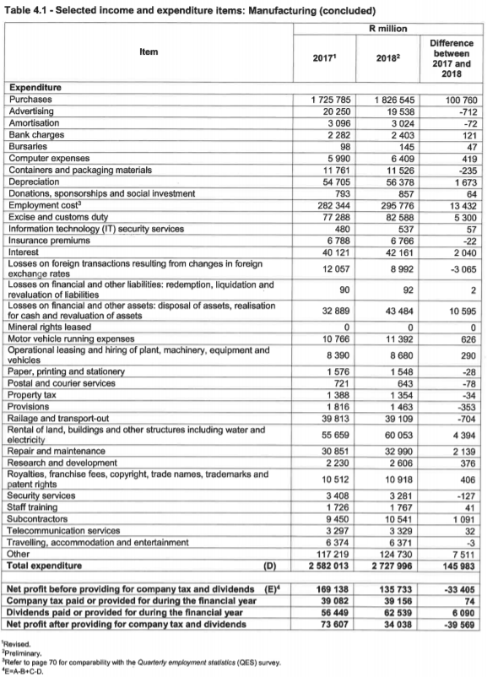
Identify Industry & obtain Financial and Manufacturing Information Related to Industry
Steps 1 & 2
Go to Table 4.1 on Page no. 24
This table provides data on the split of expenditure for a typical manufacturing setup. Record these values for expenditure and classify them into MOH, GSA, DL and DM

Slide 11
Obtain Financial and Manufacturing Information Related to Industry
Step 2
 | 2018 (in R million) | Assumptions | Percentage of total revenue
Purchases | 1826545 | DM | 64.6%
Advertising | 19538 | GSA | 0.7%
Amortisation | 3024 | GSA | 0.1%
Bank Charges | 2403 | GSA | 0.1%
Bursaries | 145 | GSA | 0.0%
Computer Expenses | 6409 | GSA | 0.2%
Containers and packaging material | 11526 | MOH | 0.4%
Depreciation | 56378 | MOH | 2.0%
Donations, sponsorship and social Investment | 857 | GSA | 0.0%
Employment Cost | 295776 |  | 10.5%
Attributable to DL | 80% | Assumption | 0.0%
Direct Labour | 236620.8 | DL | 8.4%
Indirect Labour | 59155.2 | GSA | 2.1%
Excise and Custom Duty | 82588 | GSA | 2.9%
IT security services | 537 | GSA | 0.0%
Insurance premiums | 6766 | GSA | 0.2%
Interest | 42161 | GSA | 1.5%
Forex Losses | 8992 | GSA | 0.3%
Financial Liability Losses | 92 | GSA | 0.0%
Financial Asset losses | 43484 | GSA | 1.5%
Motor Vehicle running expenses | 11392 |  | 0.4%
*50% attributable to MOH | 5696 | GSA | 0.2%
*50% attributable to SGA | 5696 | MOH | 0.2%
Operating leasing of plant, machinery, equipment and vehicles | 8680 | MOH | 0.3%
Paper, printing, stationery | 1548 | GSA | 0.1%
Postal and courier services | 643 | GSA | 0.0%
Property Tax | 1354 | GSA | 0.0%
Provisions | 1463 | GSA | 0.1%
Railage and transport out | 39109 | GSA | 1.4%
Rental of land, building and other structures including water and electricity | 60053 | GSA | 2.1%
Repair and maintenance | 32990 | MOH | 1.2%
R&D | 2606 | GSA | 0.1%
Royalties etc | 10918 | GSA | 0.4%
Security services | 3281 | GSA | 0.1%
Staff training | 1767 | GSA | 0.1%
Subcontractors | 10541 |  | 0.4%
* 50% attributed to DL | 5270.5 | DL | 0.2%
*25% attributed to MOH | 2635.25 | MOH | 0.1%
*25% attributed to SGA | 2635.25 | GSA | 0.1%
Telecommunication services | 3329 | GSA | 0.1%
Travelling, accomodation and entertainment | 6371 | GSA | 0.2%
Other | 124730 | GSA | 4.4%
Total expenditure | 2727996 |  | 96.5%
Record the values of the following items and classify them as DM, DL, MOH and GSA:
Calculate each expenditure item as a percentage of total revenue. These percentages will be used as a proxy to split the expenditure of “Casting of iron, steel and non-ferrous metals”

Slide 12
Use Financial and Manufacturing Information to Calculate Ratios
Step 3
1. Calculate the Direct Material (DM) ratio as: Purchases ÷ Total Income
2. Calculate the value for Direct Labor as follows:
(Salaries and wages paid* 80%) ÷ Total Income
1.
 | Purchases | 22,537
 | Total Income | 41,544
 | Direct Material (DM) | 54.3%
 | Salaries and wages paid | 7,780
 | Attributable to Direct Labor | × 80%
 | Total Income | 41,544
 | Direct Labor | 15%
2.

Slide 13
Use Financial and Manufacturing Information to Calculate Ratios
Step 3
3. Calculate Profit before tax ratio (PBT) as:
Profit Before Tax ÷ Total Income
4. Calculate MOH using the proxy percentages from the Annual Financial Statistics report
 | Net profit/loss before tax | 1,716
 | Total Income | 41,544
 | Profit before tax (PBT) | 4.13%
3.
MOH | Percentage of total Revenue
Containers and packaging | 0.41%
Depreciation | 1.99%
Operating leasing of plant, machinery, equipment and vehicles | 0.31%
Repair and maintenance | 1.17%
Subcontractor fees attributable to MOH (25%) | 0.09%
Motor vehicle expense *50% attributable to SGA | 0.20%
Total MOH | 4.17%
4.
Notes:
Korea-
Basic Metal Manufacturing
COGS 116,108,609
DM 79,607,506
DM/COGS=68%

Slide 14
Use Financial and Manufacturing Information to Calculate Ratios
Step 3
5. Calculate GSA as follows:
1-(DL+DM+MOH+PBT)
5.
 | Total Income | 100%
 | Direct Material | - (54.3%
 | Direct Labor | + 15%
 | MOH | + 4.2%
 | PBT | + 4.1% | )
 | GSA | 22.4%

Slide 15
Present all your calculated ratios in the cost breakdown format
Industry cost profile for “Casting of iron, steel and non-ferrous metals in South Africa”
 | Direct Material (DM) | 54.3%
 | Direct Labor (DL) | 15%
 | Manufacturing Overhead (MOH) | 4.2%
 | Cost of Goods Sold (COGS) | 73.5%
 | SGA & Other Expenses | 22.4%
 | Profit Before Tax (PBT) | 4.1%
 | Total Sales | 100.0%
Ratios calculated from ”Stats SA”

